Slide 1
AVL Trees
3rd Grade
College of Computer Science and Information Technology
Department of Computer Science
Data Structures
Lecture 5
Instructor: Ghazwan Abdulnabi Al-Ali
University of Basrah, Iraq

Slide 2
Sibling

Slide 3
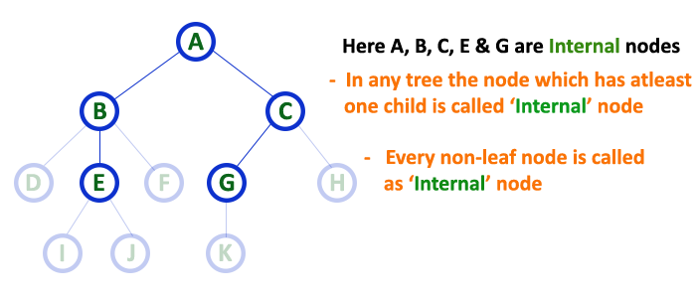
Internal

Slide 4
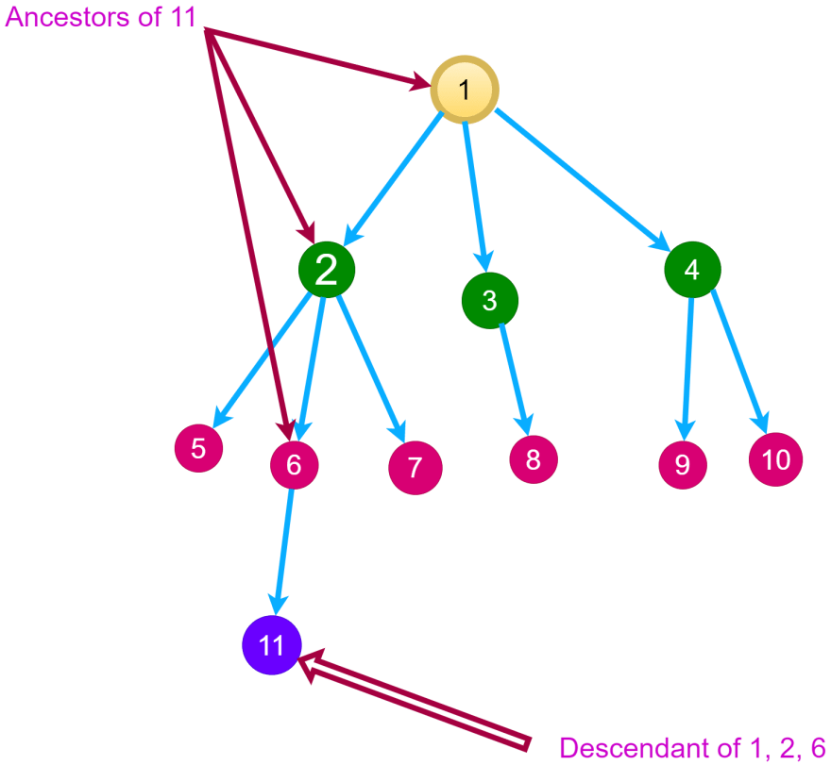
Ancestors

Slide 5
Subtree

Slide 6
AVL
balance factor = Left-Right.
8
5
11
2
6
1

Slide 7
AVL
+2
balance factor = left-right.
8
3-1= +2
5
11
2
6
1

Slide 8
AVL
+2
balance factor = left-right.
8
+1
2-1= +1
5
11
2
6
1

Slide 9
AVL
+2
balance factor = left-right.
8
+1
1-0= +1
5
11
+1
2
6
1

Slide 10
AVL
+2
balance factor = left-right.
8
+1
0
0-0= 0
5
11
+1
0
2
6
0
1

Slide 11
AVL (Single Rotation) Case 1
+ 2
+ & +
Turn Right
8
+ 1
0
5
11
+1
0
2
6
0
1

Slide 12
AVL (Single Rotation) Case 1
+ 2
+ & +
Turn Right
8
+ 1
0
5
5
11
+1
0
2
8
2
6
عائم
1
6
11
0
1

Slide 13
AVL (Single Rotation) Case 2
- & -
Turn Left
- 2
10
0
- 1
5
15
0
-1
12
20
0
30

Slide 14
AVL (Single Rotation) Case 2
- & -
Turn Left
- 2
10
0
15
- 1
5
15
0
10
20
-1
12
20
5
12
30
عائم
0
30

Slide 15
AVL (Double Rotation) Case 1
50
30
70
20
40
35
45
36

Slide 16
AVL (Double Rotation) Case 1
+ & -
Turn Left
Turn Right
+ 3
50
- 2
0
30
70
0
+1
20
40
-1
0
35
45
0
36

Slide 17
AVL (Double Rotation) Case 1
+ & -
Turn Left
+ 3
50
50
- 2
0
30
70
40
70
0
+1
20
40
30
45
-1
0
20
35
35
45
عائم
0
36
36

Slide 18
AVL (Double Rotation) Case 1
+ & -
Turn Right
50
40
40
70
30
50
30
45
20
35
45
70
عائم
20
35
36
36

Slide 19
AVL (Double Rotation) Case 2
- & +
Turn Right
Turn Left
- 3
50
0
+ 2
30
70
+1
0
60
80
-1
0
55
65
0
56

Slide 20
AVL (Double Rotation) Case 2
- 3
- & +
Turn Right
50
50
0
+ 2
30
70
30
60
+1
0
60
80
55
70
-1
0
55
65
56
80
65
0
56

Slide 21
AVL (Double Rotation) Case 2
Turn Left
60
50
50
70
30
60
30
55
65
80
55
70
عائم
56
56
80
65

Slide 22
Thank You

